Slide 1
Week 12 progress report
Eunice Orenge
Laban Mwangi
Stephen Kinuthia
Victor Ngatia

Slide 2
01
Complete & test the buck converter.
Objectives
02
Receive and start tests using the new controller.
01
Develop an algorithm to plot tracks inside a geofence.
03

Slide 3
Complete and test the buck converter.
We finished all work related to the buck converter which
included designing the circuit in Kicad, simulating the circuit
in Proteus software , testing the circuit on a breadboard and
fabricating the circuit on a PCB.
01
One of the issues we faced while fabricating the PCB was that
we still have not found terminal blocks for the input and output.
We are still looking in local and online shops for them while also
looking onto how to use other connection methods.

Slide 4
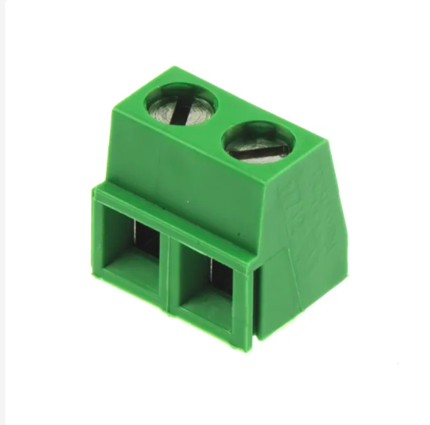
01
COMPLETE AND TEST BUCK CONVERTER
Fig. The terminal blocks we are looking for.

Slide 5
Receive and start tests using the new controller.
We still haven’t received the controller from the local
supplier. We therefore have not been able to start any
of the tests we had planned to do.
Communication with the local supplier is currently being
made and we are hoping the new controller will have arrived
by the start of the next week.
02

Slide 6
Develop an algorithm to plot tracks inside a geofence.
On this matter , we were able to create a User Interface
whereby a user could plot their farm on the mapview.
This would be called the geofence.
The next step would to create an algorithm to create tracks
inside the geofence. It is these tracks that the tractor would
follow autonomously to plough the farm successfully.
To preview the web app , go to this link :
https://jibebe-webapp-64k0z8b4y-kinuthiiia.vercel.app/
03

Slide 7
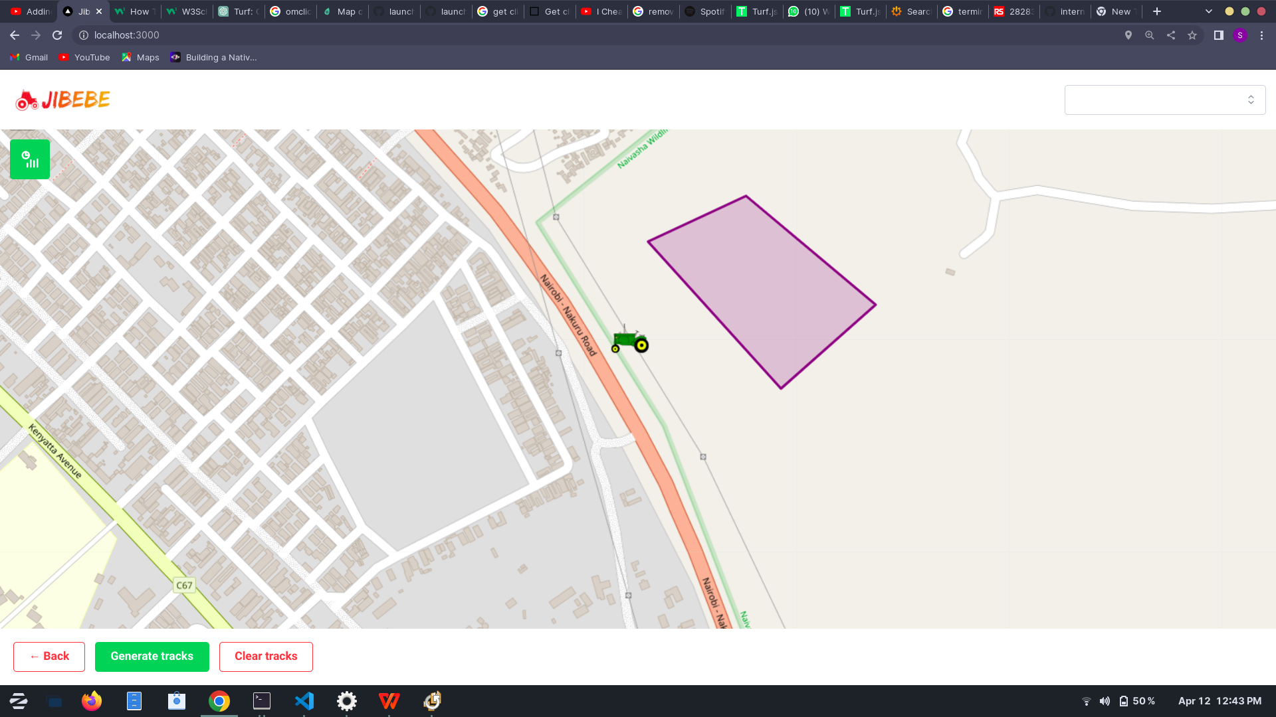
03
THE USER INTERFACE
To create a geofence ,
Click on any 3 or more points
inside the map to create a
polygon as shown in the figure.
To go back a step back, click
the ‘Back’ button.
When satisified with the area,
click ‘generate tracks’ to create
plough tracks on the area.
To clear the tracks , click the
‘Clear tracks’ button.
Fig. Creating a geofence

Slide 8
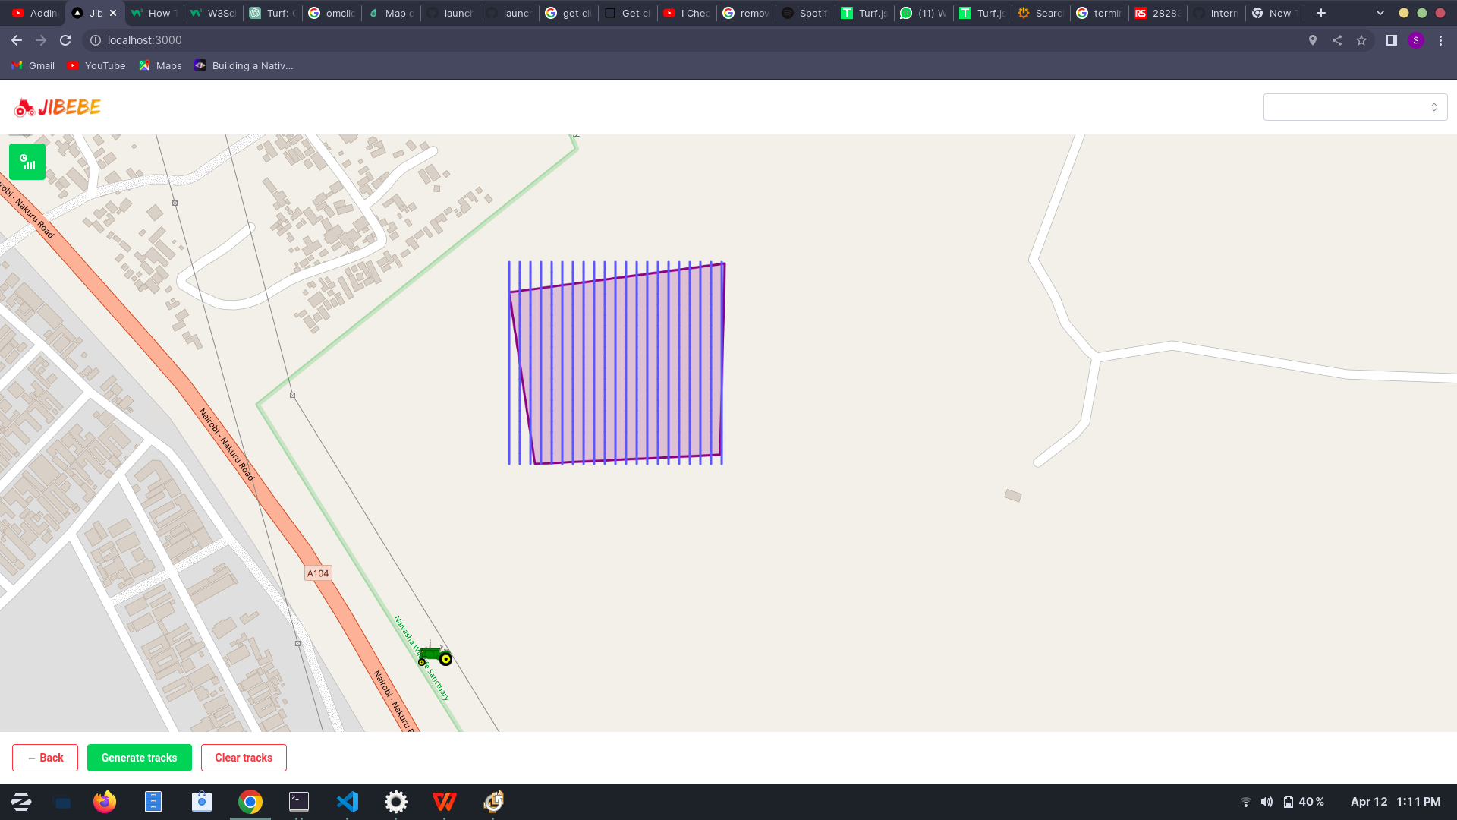
03
THE USER INTERFACE
As evident in the figure adjacent,
the generated tracks exceed the
bounds of the polygon and the
are not connected.
More thoughts are being put
together to be able to solve the
above problems.
Fig. Generating tracks
The source code for the webapp can be found at:
https://github.com/jibebe-jkuat/internship2023/tree/main/electrical/jibebe-webapp

Slide 9
THE END ,
THANK YOU!

